Slide 1



Bi-Weekly Update 5
Team 32: Abhi Singh, Holden Haile, Kelton Chesshire Sponsor: Eric Lloyd Robles TA: Eric Lloyd Robles
Notes:
Michelle

Slide 2
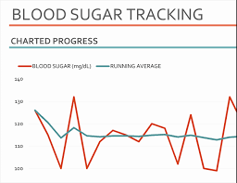
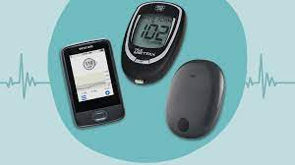
Problem Statement
In the U.S. Alone over 10% of the population suffers from Diabetes.
Type 1 diabetes requires monitoring of blood sugar levels 4-10 times a day.
The process can become a guess and check game with inconsistent data and little comfort for the user.

Slide 3
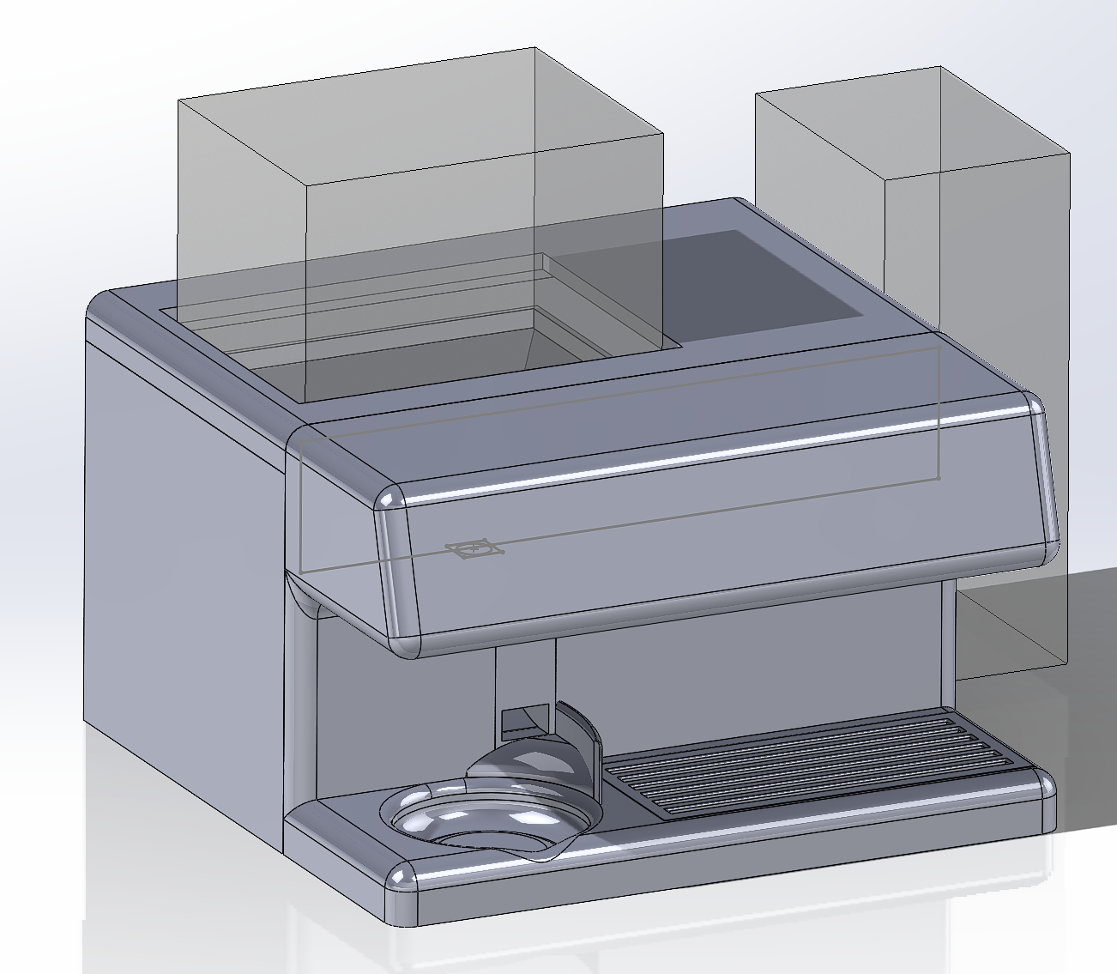
Solution Proposal
Dispense carbohydrates in a consistent, accurate, and easily-consumable manner.
Provide the user with information regarding their personal blood sugar patterns.

Slide 4
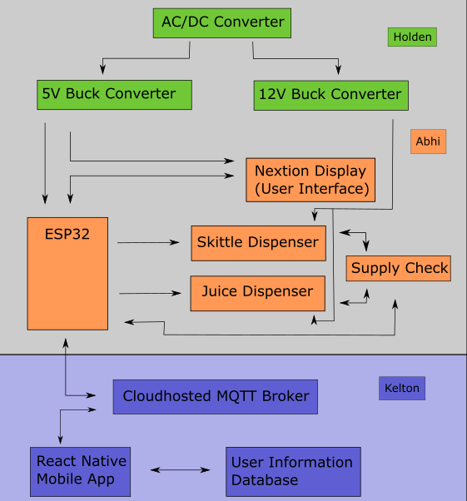
System Overview
Power Supply
Dispenser
Application

Slide 5
Project Timeline
Check point 1
Check point 2
Check point 3
Check point 4
Final Product
Discuss System Improvements
Subsystem Improvements
Major Project Design
Final Subsystem Integration
Preparation for Final Presentation & Demo
We focused on how to improve our subsystems from the good baseline from 403
Subsystem Improvements will be made and tested
Design Housing and PCBs for Dispenser, App integration with Health Apps, HMI control implemented
Dispenser and Power Supply will be installed in the housing, testing and validation of System: Dispenser powered with our Power Supply and Tested with Our App
Final Tweaks to subsystems if needed, polishing the product for presentation and testing user experience
Notes:
Eric

Slide 6
Housing Design
Holden Haile
Accomplishments since last presentation 17 hrs of effort | Ongoing progress/problems and plans until the next presentation
Learned the basics of solidworks from Ahbi Created first iteration of housing in solidworks | Final adjustments before submitting for 3D print

Slide 7
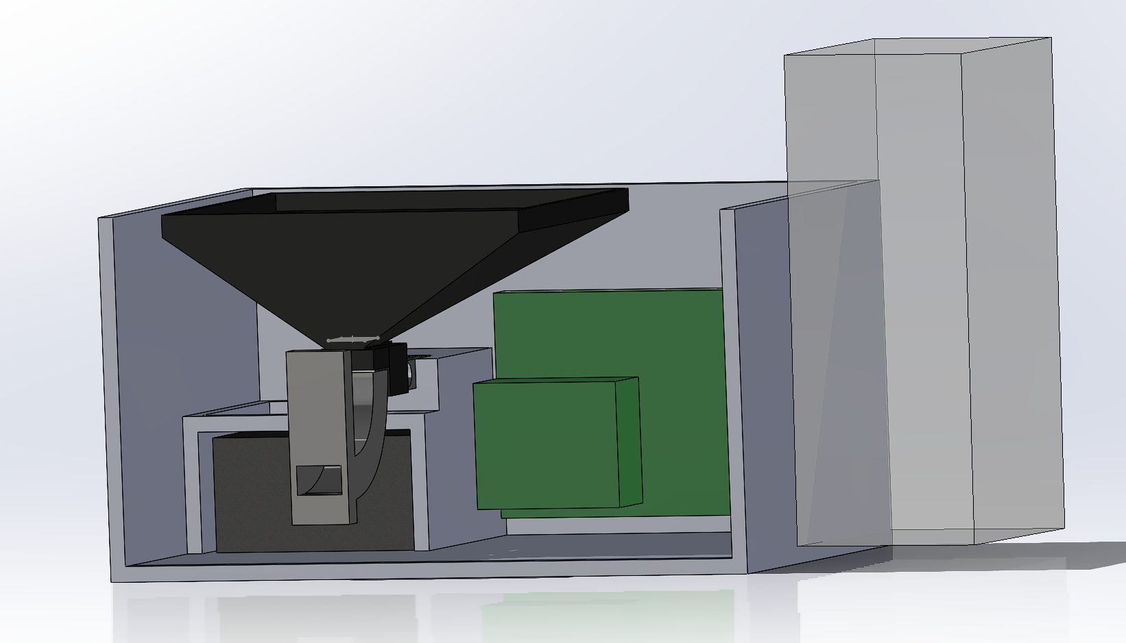
Housing Design
Holden Haile
Housing design in cooperation with Abhi
Housing will hold:
Juice & Skittle Dispensers
Power Supply & Surge Protector
Front Facing Nextion Display
Dispensing Tray

Slide 8
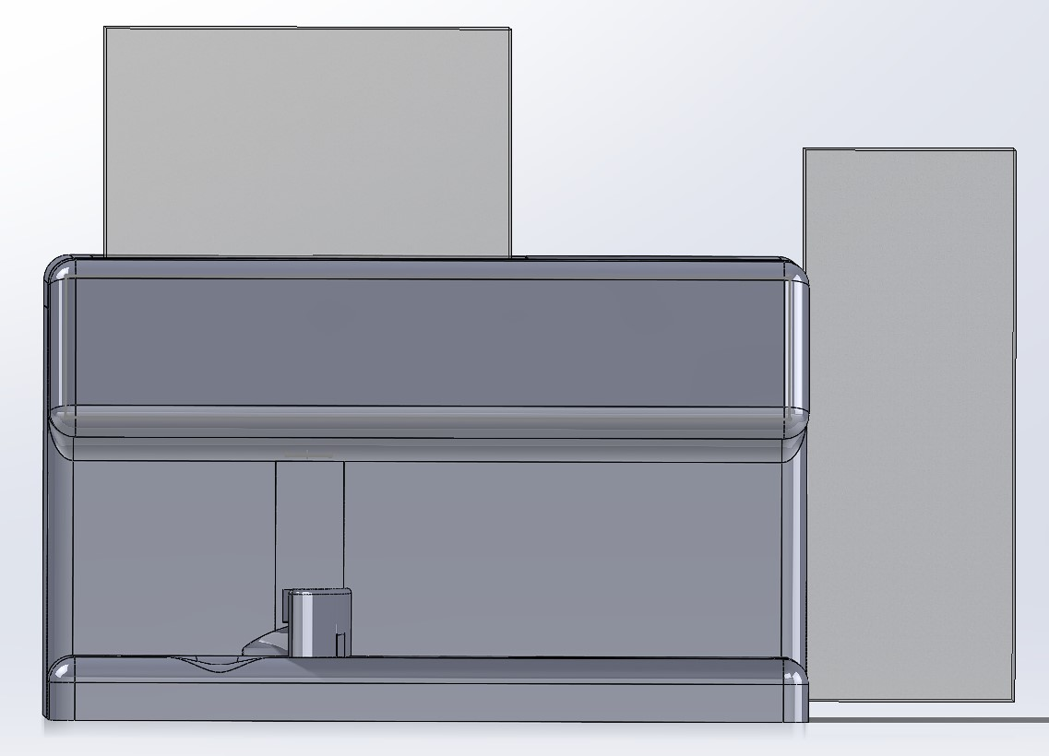
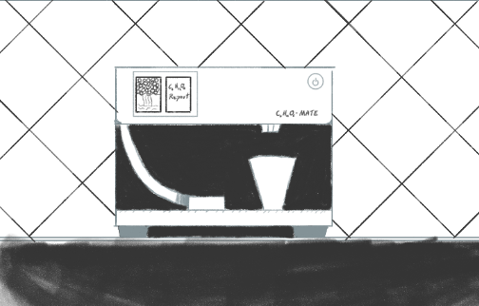
Beginning Vision vs Housing Design

Slide 9
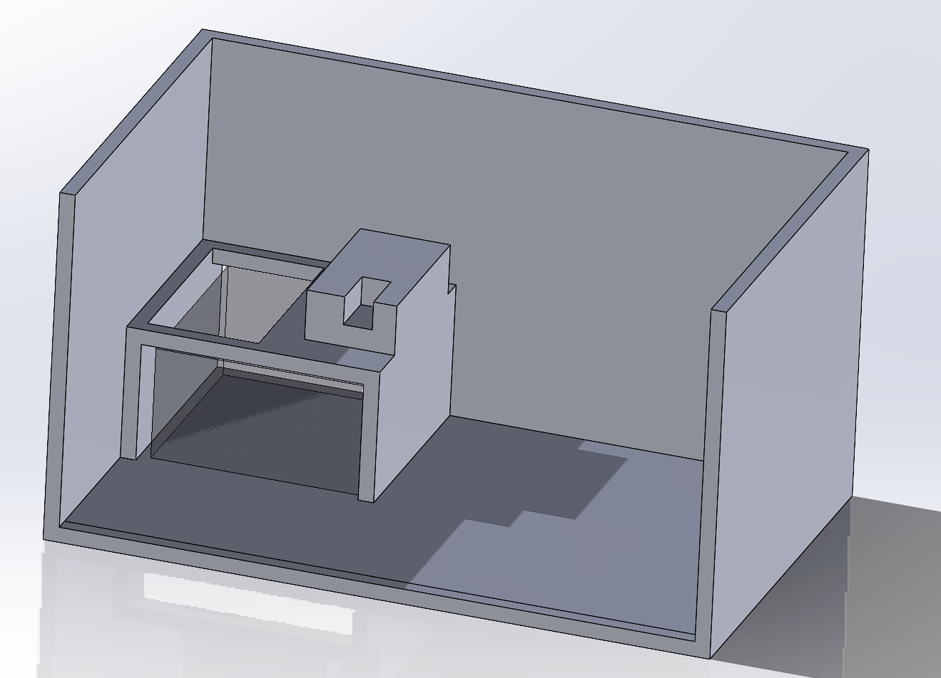
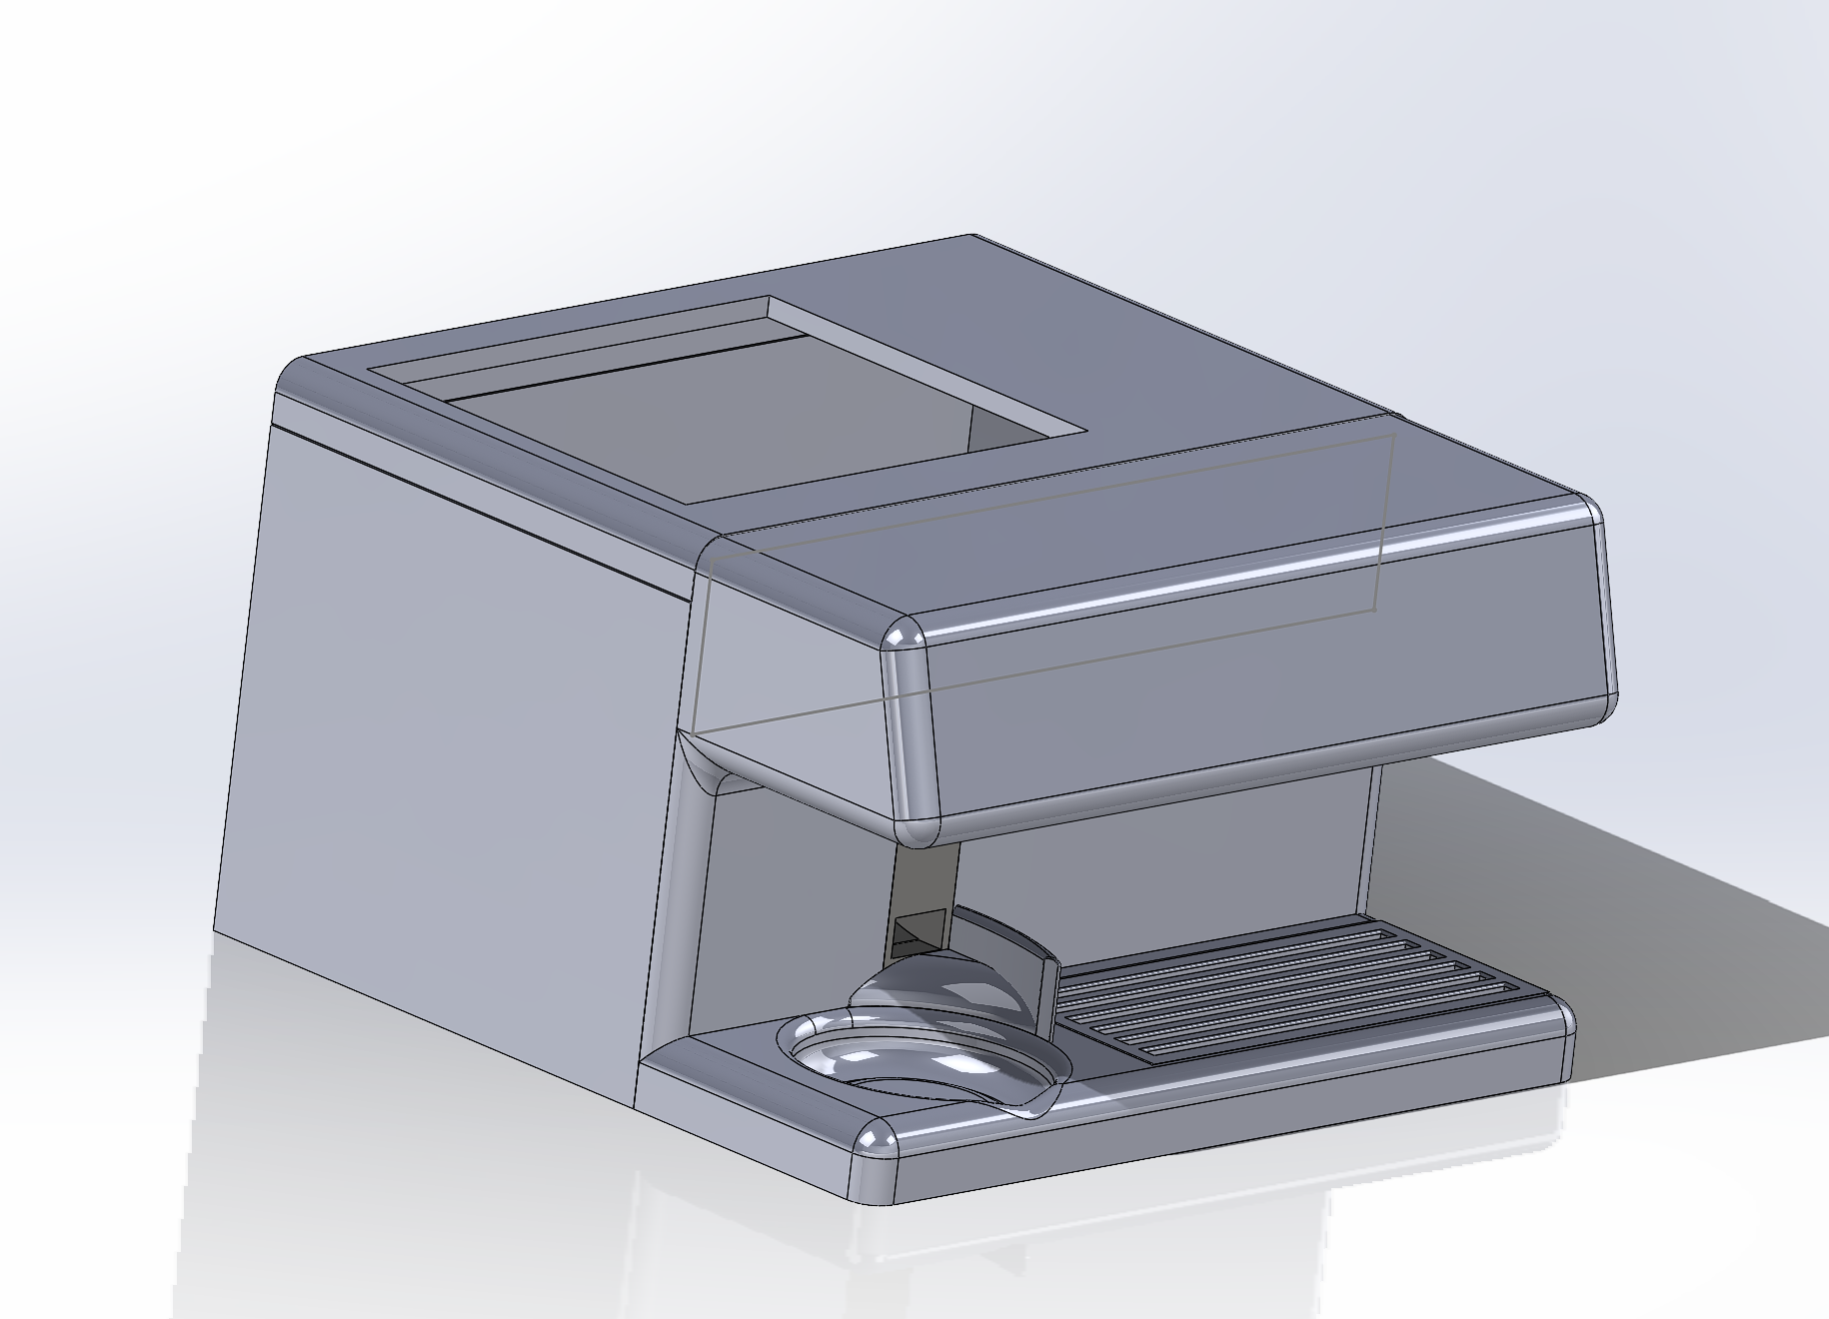
Housing Design

Slide 10
Dispenser
Abhi Singh
Accomplishments since Last Update 7 hrs | Ongoing progress/problems and plans until the next presentation
Finished designing the PCB and validated the traces alongside the breadboarded circuit Ordered the PCB Helped Holden with the dispenser housing dimensions | Design Nextion Display pages for user interface using Kelton’s Canva Designs and test with ESP32 Build the dispenser using completed 3D prints and our various electronic components

Slide 11
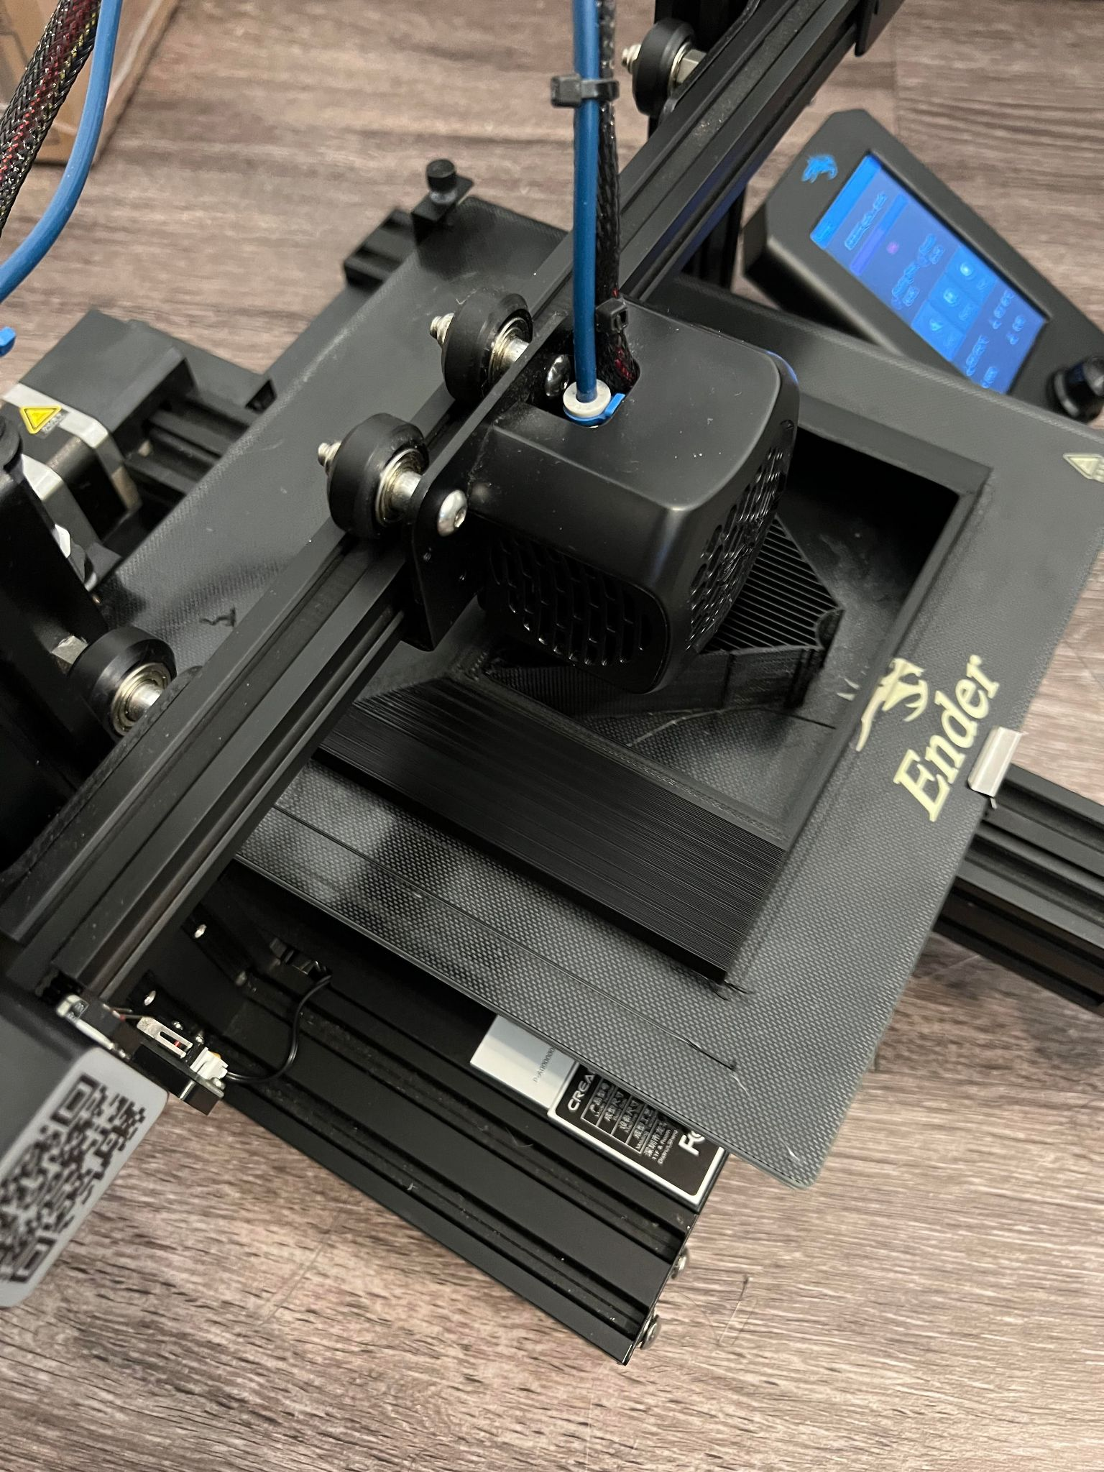
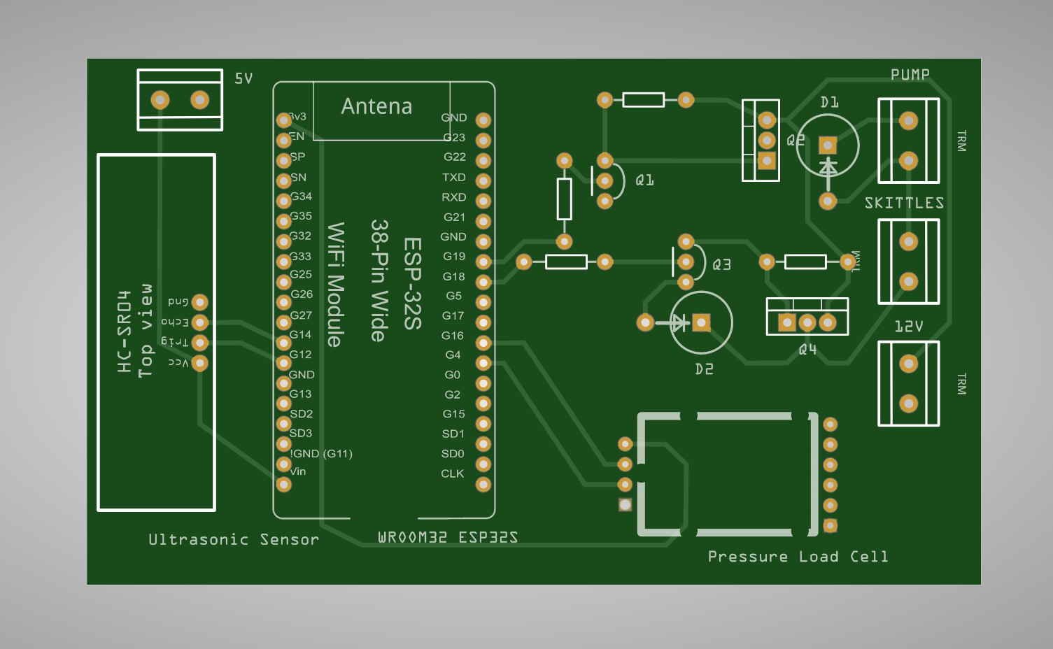
Dispenser
Abhi Singh
PCB is designed, reviewed, and ordered
Currently running prints for completed CAD parts

Slide 12
Application
Kelton Chesshire
Accomplishments since Last Update 9 hrs of effort | Ongoing progress/problems and plans until the next presentation
Backend deployment and setup Notification Service deployment | More information screens Nextion Display UI

Slide 13
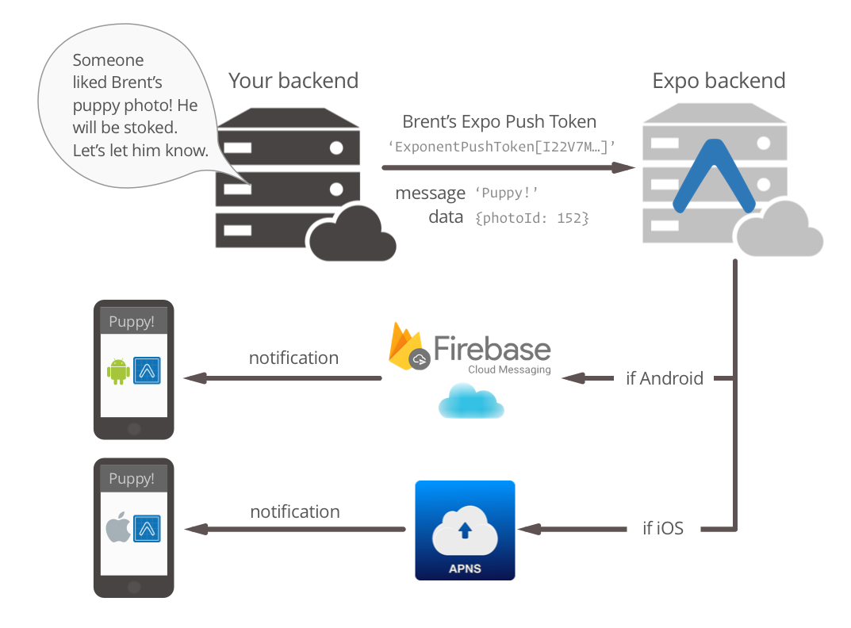
Application
Kelton Chesshire
BACKEND:
Sends “STOCK” through MQTT to all CHO-MATE devices
CHO-MATE:
Sends back Liquid and Skittle amounts
BACKEND:
If below 20%, send low notification to Application

Slide 14
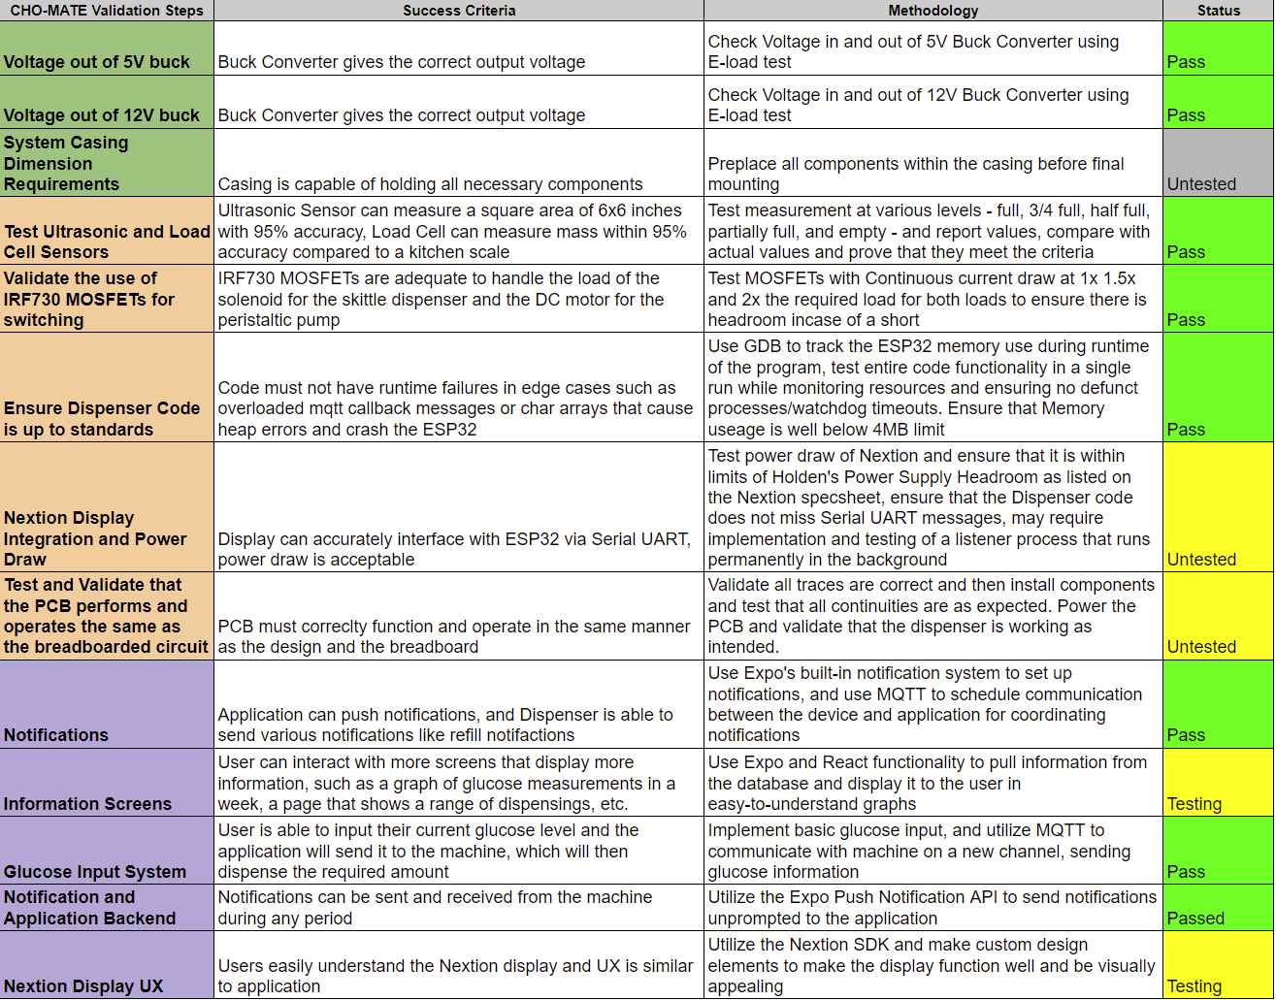
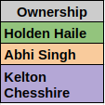
Validation Plan

Slide 15
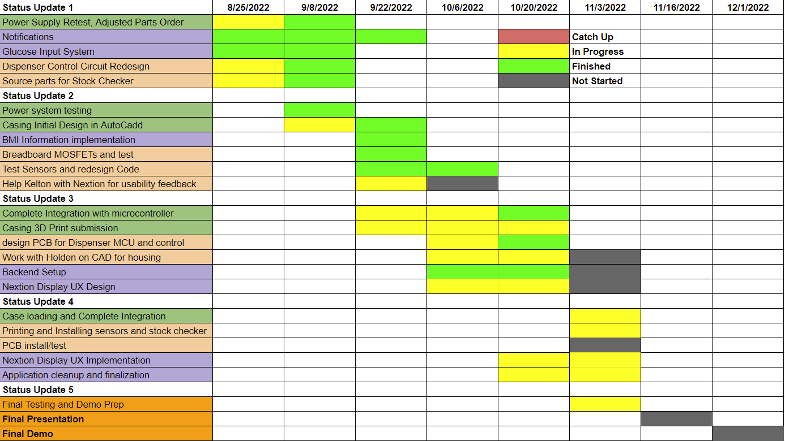
Execution Plan

Slide 16
Questions?

